Slide 1
Linux Performance
국민대학교 임베디드 연구실
경 주 현
2017 LG MC 인재육성팀 교육

Slide 2
Outline
Performance
Locking
Multi-core Scalability
Linux Kernel Synchronization History
Ticket Lock
Queued Lock(MCS)
RCU
Nonblocking list(Linux Lock-less list)

Slide 3
Why talk about performance?

Slide 4
Why talk about performance?
Servers? Vs. Embedded Systems?
Performance Scalability Vs. Energy
Many kernel developers focused on performance scalability.

Slide 5
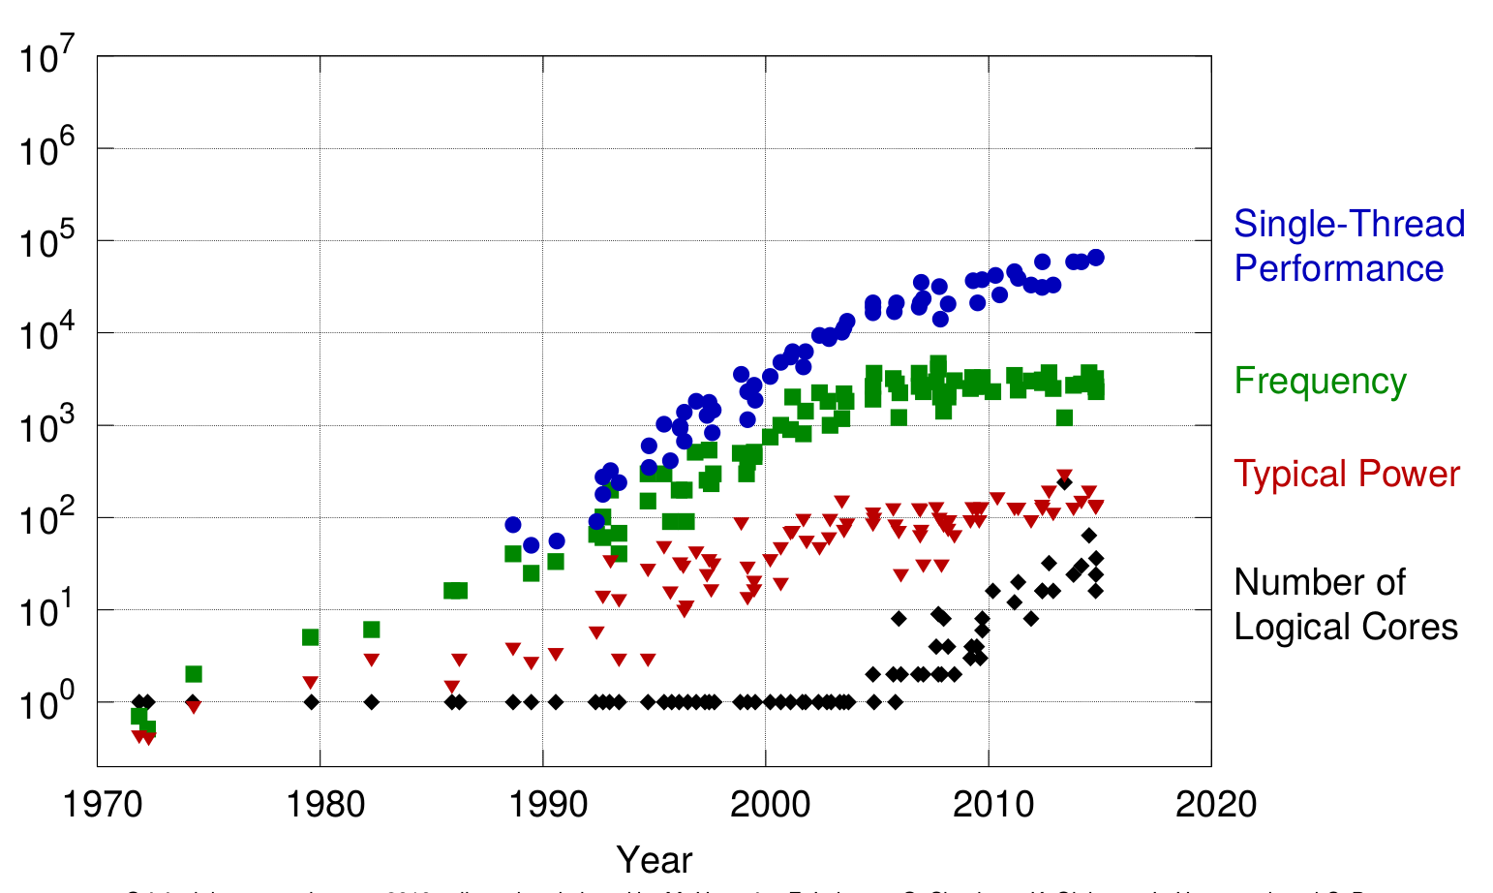
CPU trends

Slide 6
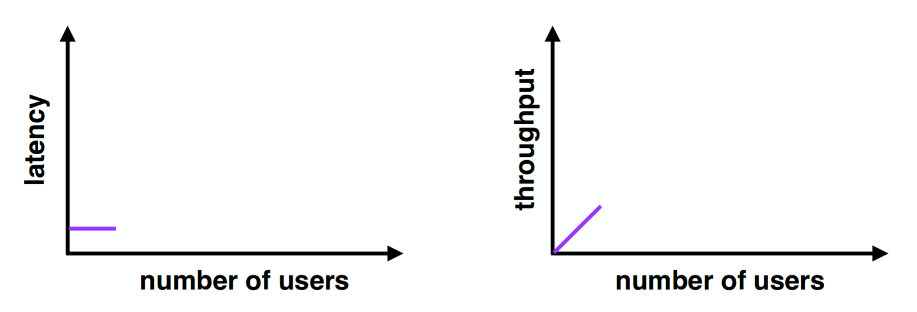
Performance - few users

Slide 7
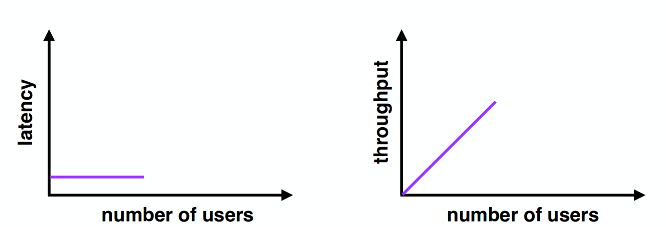
Performance - moderate users

Slide 8
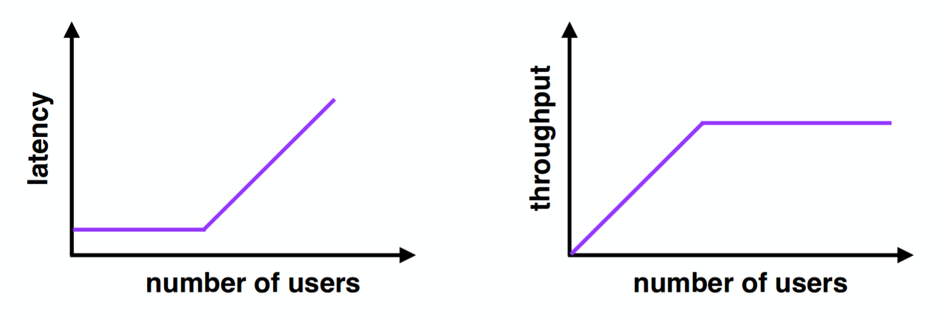
Performance - many users

Slide 9
Performance
How to Improve Performance?

Slide 10
Two Easy Steps
Measure the system to find the bottleneck

Slide 11
Two Easy Steps
Measure the system to find the bottleneck
Reduce the bottleneck

Slide 12
Two Easy Steps
Measure the system to find the bottleneck
Reduce the bottleneck
1. Better algorithms

Slide 13
Two Easy Steps
Measure the system to find the bottleneck
Reduce the bottleneck
1. Better algorithms
2. Cache data : Ex) page cache, slab

Slide 14
Two Easy Steps
Measure the system to find the bottleneck
Reduce the bottleneck
1. Better algorithms
2. Cache data : Ex) page cache
3. Concurrency
CPU: --A-- --B-- --C--
Disk: --A-- --B-- --C--
Apply concurrency
CPU: --A----B----C-- ...
Disk: --A----B--
4. Parallelism
CPU1: --A-- --D--
CPU2: --B-- --E--
CPU3: --C-- --F--

Slide 15
Today talk about multi-core speed-up
Concurrency and Parallelism
Apps want to use multi-core processors for parallel speed-up
kernel must deal with parallel system calls
Parallel access to kernel data
buffer cache, processes

Slide 16
What is multi-core scalability problem?

Slide 17
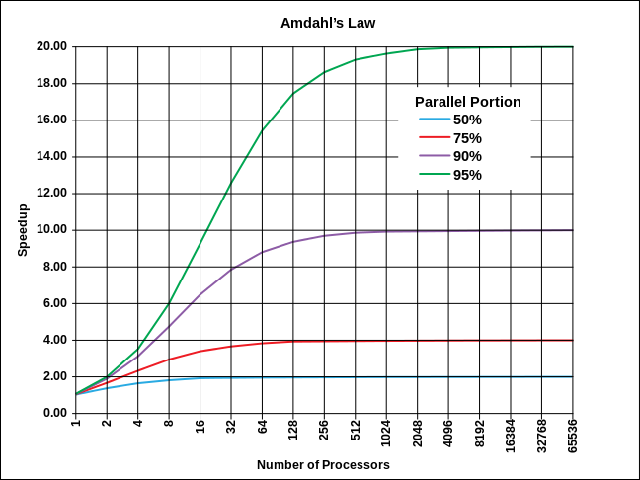
What is multi-core scalability problem?
Sequential Parts of a Parallel Program!!!
Amdahl’s Law: S = 1 / (1 – p + p/n)
90% parallelizable software
10 processors: 5.3x speedup
20 processors: 6.9x speedup
40 processors: 8.2x speedup
and

Slide 18
What is multi-core scalability problem?
Sequential Parts of a Parallel Program!!!
Amdahl’s Law: S = 1 / (1 – p + p/n)
90% parallelizable software
10 processors: 5.3x speedup
20 processors: 6.9x speedup
40 processors: 8.2x speedup
and Locking!!

Slide 19
Why talk about locking?
Locks help with correct sharing of data
Locks can limit parallel speedup

Slide 20
Locking
Allow only one CPU to be inside a piece of code
at a time.
The lock abstraction
lock l
acquire(l) x = x + 1 -- "critical section" release(l)

Slide 21
The type of Locks
Exclusive Lock
spinlock, mutex
Reader-writer lock
reader-writer semaphore
RCU(Read Copy Update)
RCU, SRCU

Slide 22
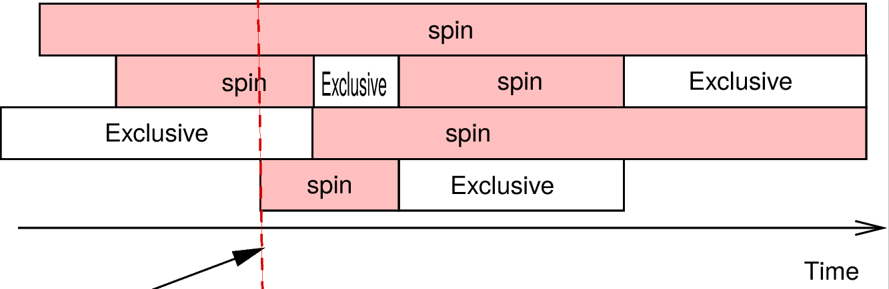
Exclusive Lock

Slide 23
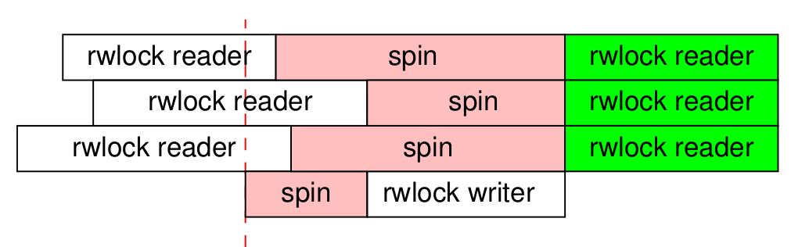
Reader-writer locks
ex) reader-writer semaphore
spin -> block
time

Slide 24
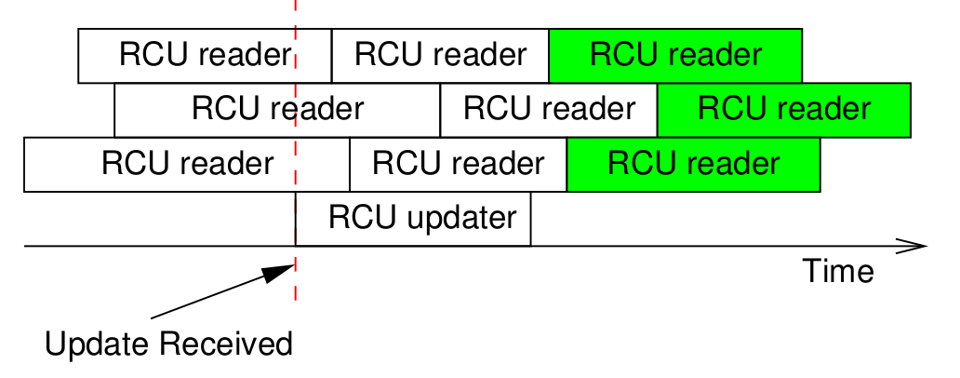
RCU(Read Copy Update)
time

Slide 25
Exclusive Lock

Slide 26
How to implement locks?

Slide 27
How to implement locks?
struct lock { int locked; }
struct lock l;
acquire(l) { while(1){ if(l->locked == 0) { l->locked = 1; return; } } }

Slide 28
How to implement locks?
why not?
struct lock { int locked; }
struct lock l;
acquire(l) { while(1){ if(l->locked == 0) { // A l->locked = 1; // B return; } } }

Slide 29
Solution
Atomic exchange instruction
SWAP or xchg : swap operation

Slide 30
Simple spin lock
Atomic exchange instruction
SWAP or xchg : swap operation
Now: acquire(l){ while(1){ if(xchg(&l->locked, 1) == 0){ break } } }

Slide 31
Why spin locks?
Don't they waste CPU while waiting?

Slide 32
Why spin locks?
Don't they waste CPU while waiting?
Spin lock guidelines:
Hold spin locks for very short times
Don't yield CPU while holding a spin lock

Slide 33
Why spin locks?
Don't they waste CPU while waiting?
Spin lock guidelines:
Hold spin locks for very short times
Don't yield CPU while holding a spin lock
Systems often provide "blocking" locks for longer critical sections
waiting threads yield the CPU but overheads are typically higher

Slide 34
Lock’s Problem
The problem is multi-core caching

Slide 35
How to ensure caches aren't stale?
core 1 : reads + caches x=10,
core 2 : writes x=11, core 1 reads x=?

Slide 36
How to ensure caches aren't stale?
core 1 : reads + caches x=10,
core 2 : writes x=11, core 1 reads x=?
answer:
"cache coherence protocol"

Slide 37
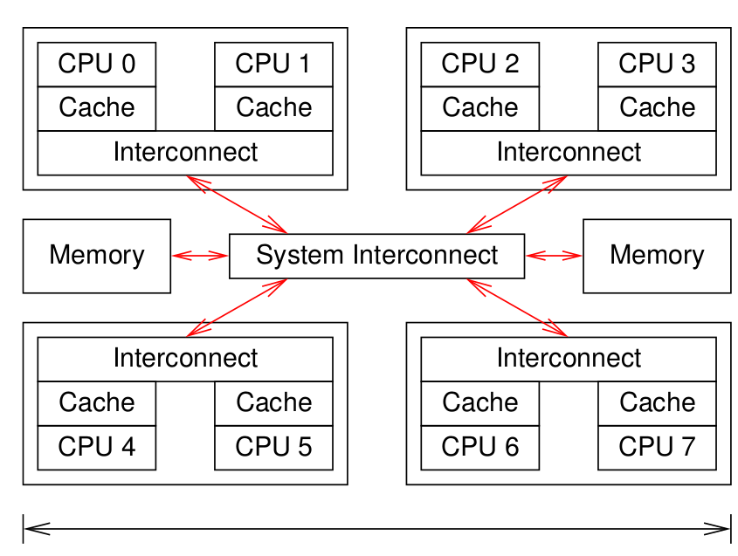
System Interconnect
Cache coherence protocol
All messages are broadcast to all cores

Slide 38
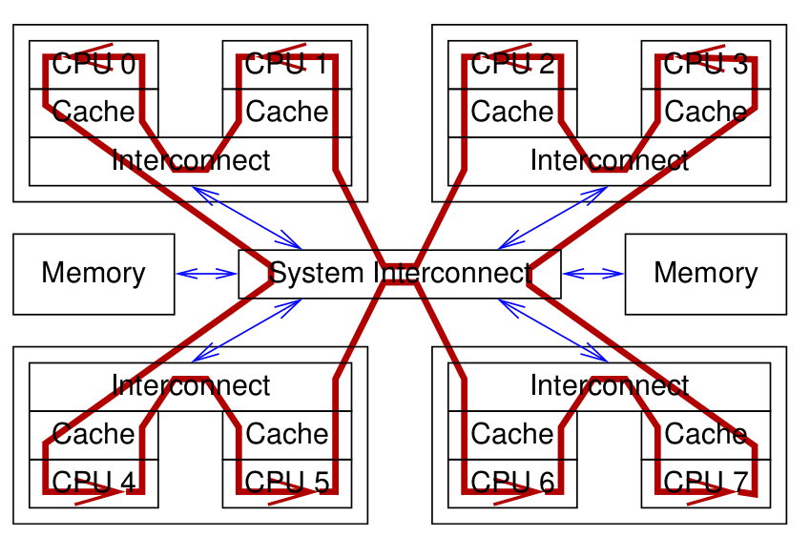
Data Flow For Global Atomic Increment
Thread a : atomic_inc(&global_value;
Thread b : atomic_inc(&global_value);
Thread c : atomic_inc(&global_value);
Thread d : atomic_inc(&global_value);
Bottleneck is usually the interconnect

Slide 39
Goal : per-core partitioning
How to improve the scalability?

Slide 40
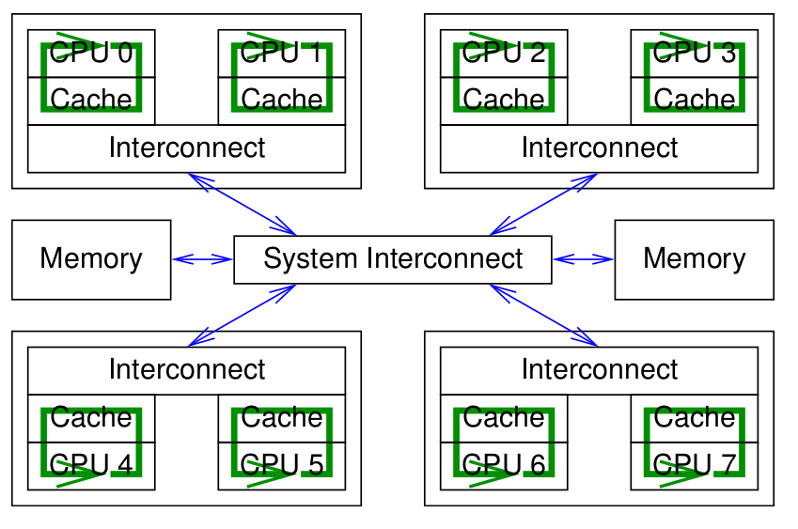
Goal : per-core partitioning
How to improve the scalability?

Slide 41
Locks and parallelism
Locks prevent parallel execution to get parallelism
How to improve parallelism.
First, use fine grained locks
minimizing the lock scope.
Second, You may need to re-design code to make it work well in parallel

Slide 42
Real World?

Slide 43
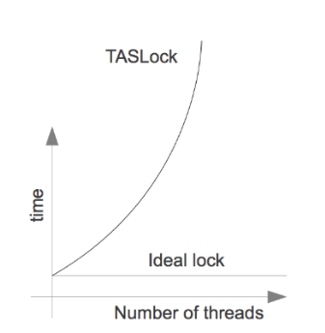
Test and Set(Old method)
T&S (*addr) {
old = *addr;
*addr = 1;
return (old == 0);
}
bool locked = false
void lock () {
while ( !T&S(locked) );
}
void unlock() {
locked = false;
}

Slide 44
Test and Set(Old method)
T&S (*addr) {
old = *addr;
*addr = 1;
return (old == 0);
}
bool locked = false
void lock () {
while ( !T&S(locked) );
}
void unlock() {
locked = false;
}

Slide 45
Data Flow For Global Atomic Increment
Bottleneck is usually the interconnect
t-s locks aren't fair

Slide 46
Ticket locks (linux):
Goal:
Read-only spin loop, rather than repeated atomic instruction
Fairness (turns out t-s locks aren't fair)
Idea:
Assign numbers, wake up one at a time
avoid constant t-s atomic instructions by waiters

Slide 47
Ticket locks
F&I (*addr) {
old = *addr;
*addr++;
return old;
}
int now_serving = 0;
int next_ticket = 0;
void lock () {
my_ticket = F&I(next_ticket);
while (my_ticket != now_serving);
}
void unlock() {
now_serving++;
}

Slide 48
Ticket locks
F&I (*addr) {
old = *addr;
*addr++;
return old;
}
int now_serving = 0;
int next_ticket = 0;
void lock () {
my_ticket = F&I(next_ticket);
while (my_ticket != now_serving);
}
void unlock() {
now_serving++;
}

Slide 49
Ticket locks Problem
Read-only spin loop, rather than repeated atomic instruction
But still bottlenecked due to cache invalidation message.
Release lock
invalidate all cpu.

Slide 50
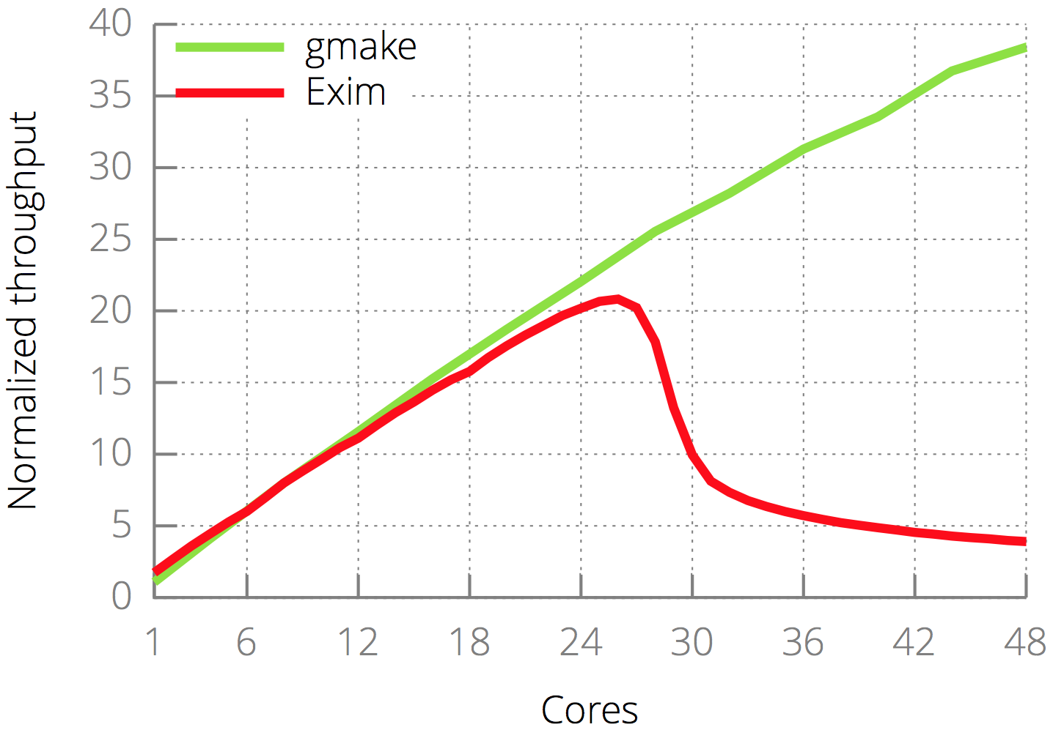
But...
Ticket lock’s problem
non-scalable lock

Slide 51
Ticket locks (linux):

Slide 52
How to make locks scale well?
A partitioning method
What if each core spins on a *different* cache line?
Avoid useless invalidations
By keeping a queue of threads
Notes:
What if each core spins on a *different* cache line?
acquire cost?
atomic increment, then read-only spin
release cost?

Slide 53
Anderson lock
Invalidate next holder's slots[]
Each thread Notifies next in line
Without bothering the others
Problem

Slide 54
Anderson lock
Invalidate next holder's slots[]
Each thread Notifies next in line
Without bothering the others
Problem: high space cost
O(lock * cores)
N slots per lock

Slide 55
MCS
Goal:
as scalable as anderson, but less space used
Idea: one list element per thread, since a thread can wait on only one lock
so total space is O(locks + threads), not O(locks*threads)
Idea: linked list of waiters per lock
1. Pushes caller's element at end of list
2. Spins on a variable in its own element
3. pops its own element

Slide 56
MCS
#define CACHELINE 64
struct qnode {
volatile void *next;
volatile char locked;
char __pad[0] __attribute__((aligned(CACHELINE)));
};
typedef struct {
struct qnode *tail __attribute__((aligned(64)));
} mcslock_t;
static inline void
mcs_unlock(mcslock_t *l, volatile struct qnode *mynode)
{
if (!mynode->next) {
if (cmpxchg(&l->tail, mynode, 0) == mynode)
return;
while (!mynode->next) ;
}
mynode->next->locked = 0; //unlock
}
static inline void
mcs_lock(mcslock_t *l, volatile struct qnode *mynode)
{
struct qnode *predecessor;
mynode->next = NULL;
predecessor = xchg(&l->tail, mynode);
if (predecessor) {
mynode->locked = 1;
predecessor->next = mynode;
while (mynode->locked) // local spin
;
}
}
3. unlock own element
Pushes caller's element at end of list
2. Spins on a variable in its own element

Slide 57
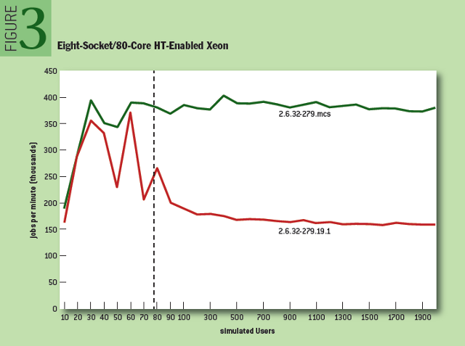
MCS and Linux scalability
“AIM7 file-system benchmark” http://queue.acm.org/detail.cfm?id=2698990

Slide 58
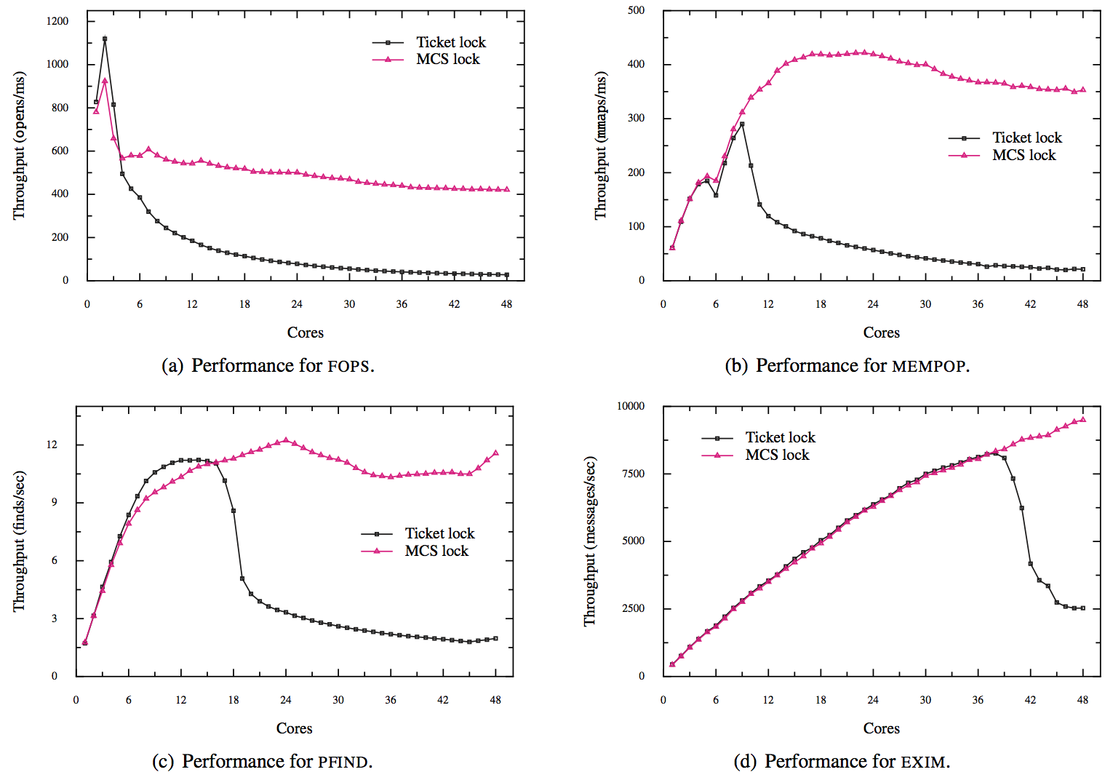
MCS and Linux scalability

Slide 59
Notes on Linux and MCS locks
The Linux developers came up with “qspinlocks”
Avoid bloating the size of the MCS
The old and unused ticket-spinlock implementation was deleted from the mainline in 2016.

Slide 60
What about blocking lock?
Linux kernel mutex or rw_semaphore (reader-writer semaphore)

Slide 61
Reader-writer lock

Slide 62
What about blocking lock?
Linux kernel mutex or rw_semaphore (reader-writer semaphore)

Slide 63
Reader-writer locks
time

Slide 64
Blocking lock Problem
Problem :
Scheduling overhead because threads yield the CPU
Block -> Runqueue -> Run
Davidlohr Bueso. 2014. Scalability techniques for practical synchronization primitives. Commun. ACM 58

Slide 65
Blocking lock
Problem :
Scheduling overhead because threads yield the CPU
Block -> Runqueue -> Run
Solution :
Hybrid Locking Models and Optimistic Spinning
Davidlohr Bueso. 2014. Scalability techniques for practical synchronization primitives. Commun. ACM 58

Slide 66
Hybrid Locking Models and Optimistic Spinning
Fastpath.
Acquire the lock atomically by modifying an internal counter such as fetch_and_add or atomic decrementing.
Midpath (aka optimistic spinning)
Tries to spin for acquisition while the lock owner is running
Spinner threads are queued up using an MCS lock
Slowpath.
Task is added to the wait queue and sleeps
Davidlohr Bueso. 2014. Scalability techniques for practical synchronization primitives. Commun. ACM 58

Slide 67
RCU

Slide 68
Blocking lock Problem
Problem :
Scheduling overhead because threads yield the CPU
Block -> Runqueue -> Run
Davidlohr Bueso. 2014. Scalability techniques for practical synchronization primitives. Commun. ACM 58

Slide 69
Blocking lock
Problem :
Scheduling overhead because threads yield the CPU
Block -> Runqueue -> Run
Solution :
RCU
Davidlohr Bueso. 2014. Scalability techniques for practical synchronization primitives. Commun. ACM 58

Slide 70
RCU
A per-core partitioning algorithm
Read-mostly data structure
Reader Lock / Unlock
enter() / exit() in per-core memory
Writer Lock / Unlock
look-up all thread’s local value and delayed free

Slide 71
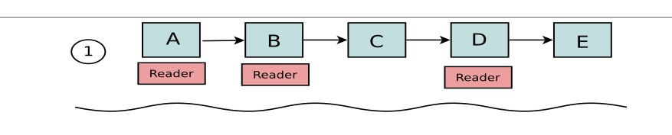
RCU Usage (Route Table Lookup)
Packet routing list
No cache coherence protocol problem
Using per-core marking

Slide 72
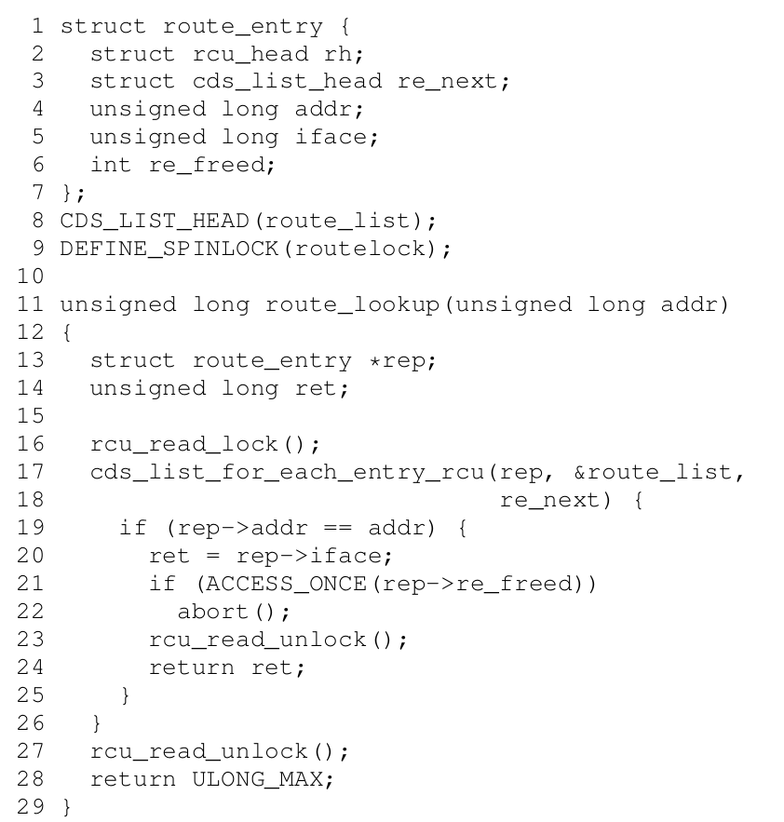
RCU Usage (Route Table Lookup)

Slide 73
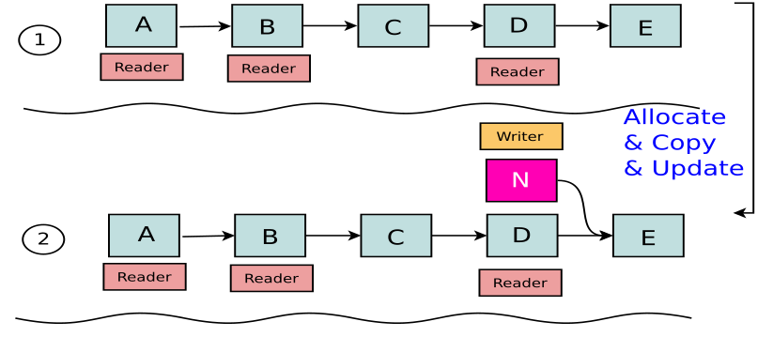
RCU (Linked List)

Slide 74
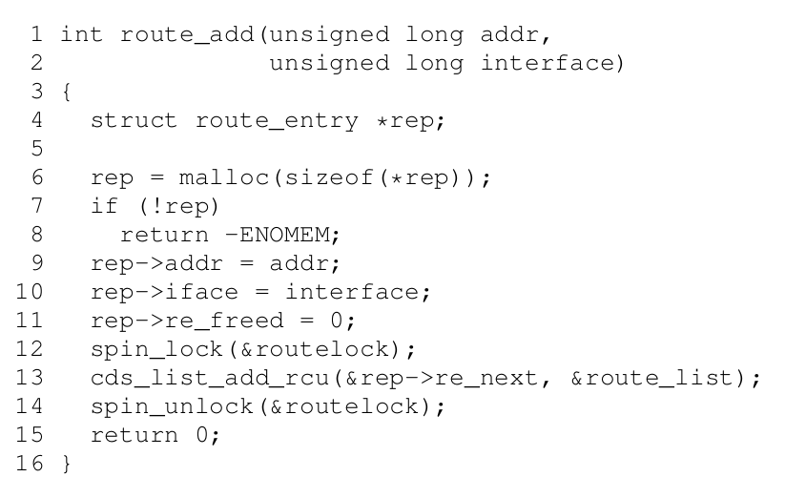
RCU Usage - add

Slide 75
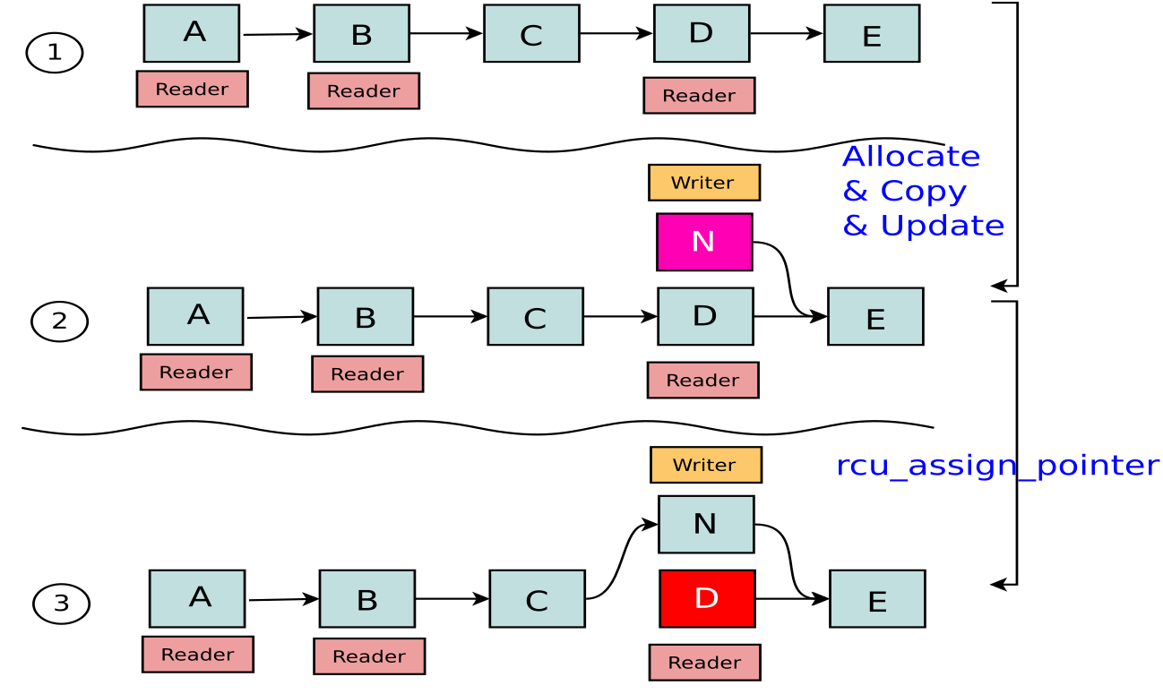
RCU (Linked List)

Slide 76
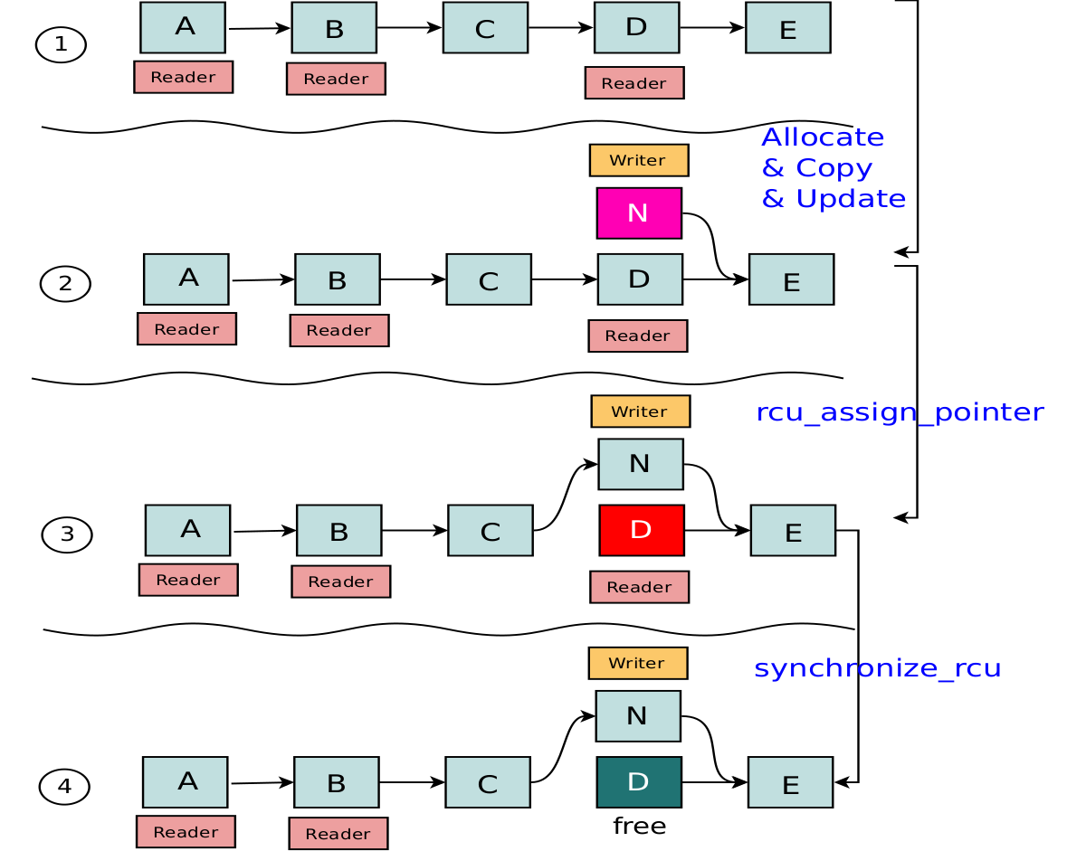
RCU

Slide 77
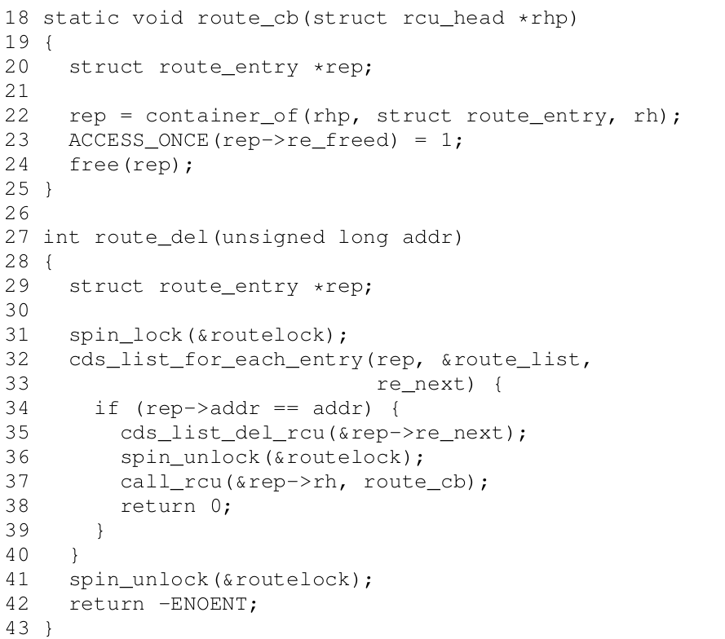
RCU Usage - remove
//rcu_assign_pointer
//synchroinized_rcu

Slide 78
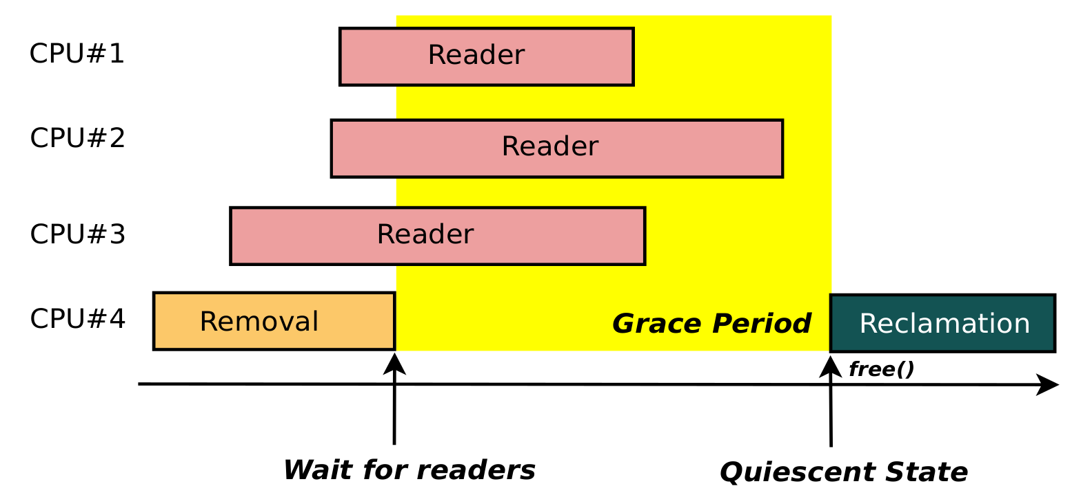
Grace Period

Slide 79
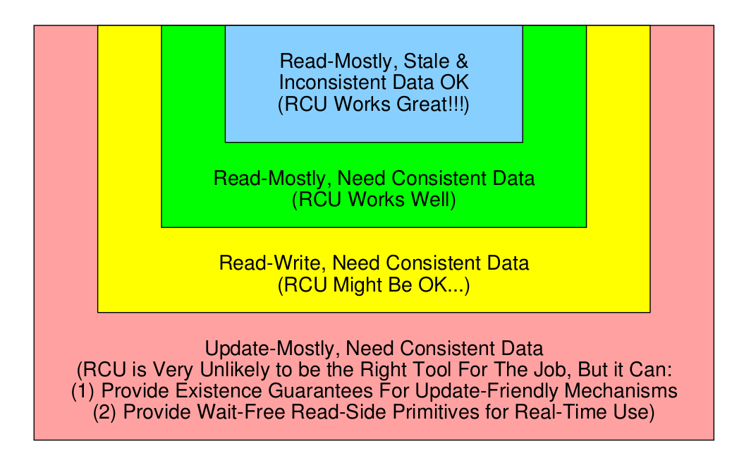
RCU Areas of Applicability

Slide 80
Non-blocking algorithms

Slide 81
Deadlock
core A core B foo(d1/a, d2/b) foo(d2/c, d1/d) lock d1 lock d2 lock d2 ... lock d1 ...

Slide 82
Deadlock
core A core B foo(d1/a, d2/b) foo(d2/c, d1/d) lock d1 lock d2 lock d2 ... lock d1 ...
Solution : Works out an order for all locks all code must acquire locks in that order
Or use a lock-less algorithm.

Slide 83
Deadlock
core A core B foo(d1/a, d2/b) foo(d2/c, d1/d) lock d1 lock d2 lock d2 ... lock d1 ...
Solution : Works out an order for all locks all code must acquire locks in that order
predict locks, sort, acquire

Slide 84
Deadlock
core A core B foo(d1/a, d2/b) foo(d2/c, d1/d) lock d1 lock d2 lock d2 ... lock d1 ...
Solution : use a lock-less algorithm.

Slide 85
Lock-less algorithms(Non-blocking algorithms)
One example : A Lock-less algorithm
struct element {
int key;
int value;
struct element *next;
};
struct element *global;
void push(struct element *e)
{
retry:
e->next = global; //A
if (cmpxchg(&global, e->next, e) != e->next) //B
goto retry;
}
struct element *pop(void)
{
retry:
struct element *e = global; //A
if (cmpxchg(&global, e, e->next) != e) //B
goto retry;
return e;
}

Slide 86
Linux’s Lock-less List
Lock-less NULL terminated single linked list
llist_add_batch
llist_del_all

Slide 87
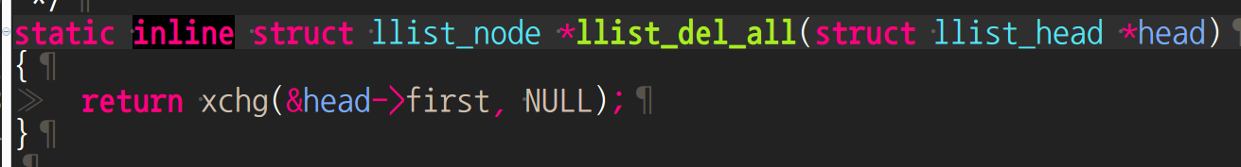
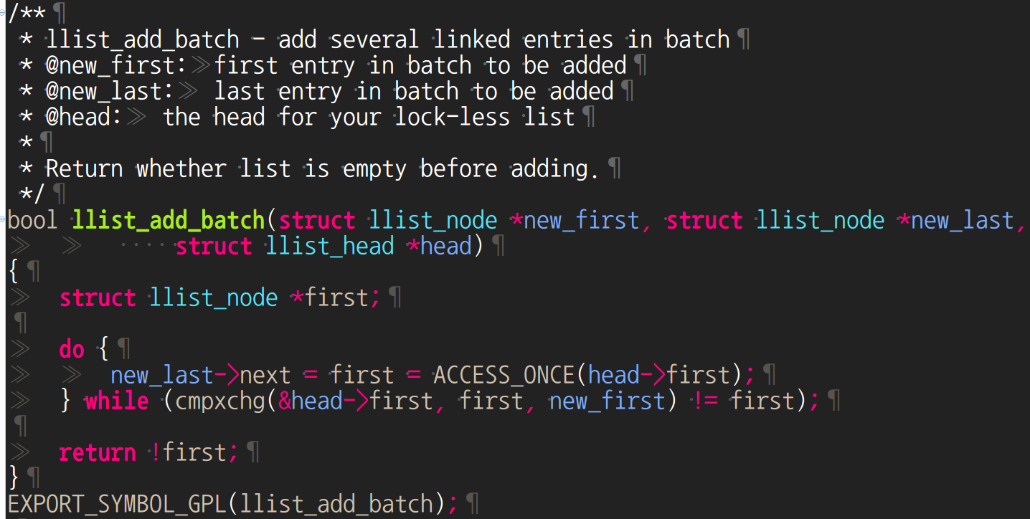
Linux lock-less data structure
lib/llist.c

Slide 88
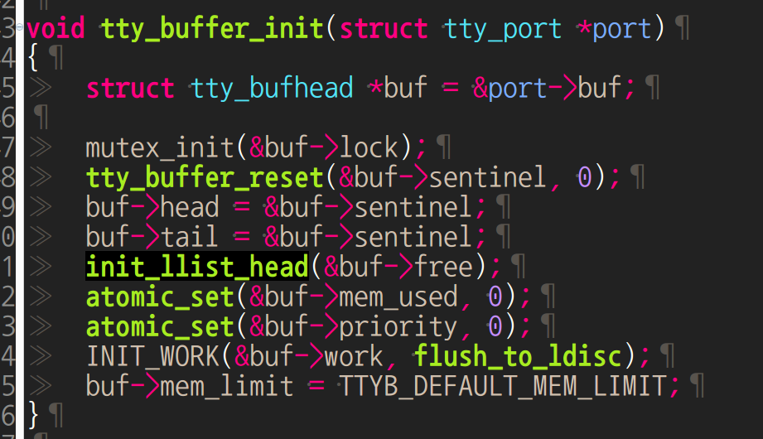
Ex) tty buffer

Slide 89
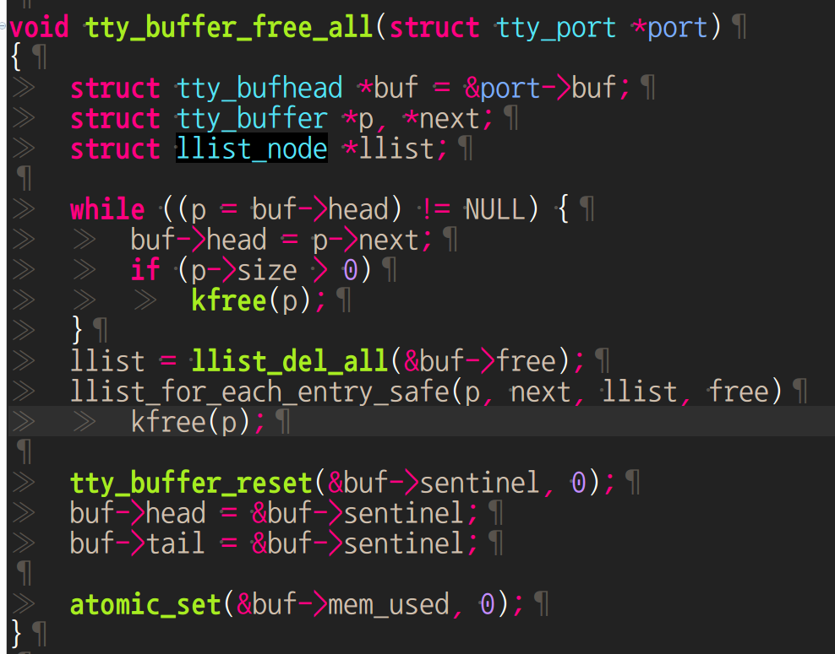
Ex) tty buffer

Slide 90
Today
process/thread -> performance -> multi-core performance scalability-> lock-> bottleneck-> cache cohere system problem-> per-core partition approach

Slide 91

Next Step.
Linux power
CFS scheduler(User level, Tools, Kernel level)
Load Balancer(Group Scheduling, Bandwidth Control, PELT)
EAS features

Slide 92
Reference
https://pdos.csail.mit.edu/6.828/2016/schedule.html
http://web.mit.edu/6.033
http://www.rdrop.com/~paulmck/
“Is Parallel Programming Hard, And If So, What Can You Do About It?”
Davidlohr Bueso. 2014. Scalability techniques for practical synchronization primitives. Commun. ACM 58
http://queue.acm.org/detail.cfm?id=2698990
"CPUFreq and The Scheduler Revolution in CPU Power Management", Rafael J. Wysocki
https://sites.google.com/site/embedwiki/oses/linux/pm/pm-qos
https://intl.aliyun.com/forum/read-916
User-level threads : co-routines
http://www.gamedevforever.com/291
https://www.youtube.com/watch?v=YYtzQ355_Co
Scheduler Activations
https://cgi.cse.unsw.edu.au/~cs3231/12s1/lectures/SchedulerActivations.pdf
https://en.wikipedia.org/wiki/FIFO_(computing_and_electronics)
http://jake.dothome.co.kr/
http://www.linuxjournal.com/magazine/completely-fair-scheduler?page=0,0
https://www2.cs.uic.edu/~jbell/CourseNotes/OperatingSystems/6_CPU_Scheduling.html
"Energy Aware Scheduling", Byungchul Park, LG Electronic
“Update on big.LITTLE scheduling experiments”, ARM
“EAS Update” 2015 september ARM
"EAS Overview and Integration Guide”, ARM TR
“Drowsy Power Management”, Matthew Lentz, SOSP 2015
https://www.slideshare.net/nanik/learning-aosp-android-hardware-abstraction-layer-hal
https://www.youtube.com/watch?v=oTGQXqD3CNI
https://www.youtube.com/watch?v=P80NcKUKpuo
https://lwn.net/Articles/398470/
“SCHED_DEADLINE: It’s Alive!”, ARM, 2017

